Slide 1
Normalization for relational Databases- Practice Question

Slide 2
Purchase Order -Attribute Analysis
ATTRIBUTE | TYPE | LENGTH | DESCRIPTION
PO-NO | N | 3 | Unique purchase order (PO) number. Many parts can be ordered in one PO
PO-DATE | D | 8 | DDMMYYYY date when PO written
EMP-CODE | C | 2 | Unique code of employee who wrote the PO
SUPP-NO | N | 3 | Unique number assigned to supplier
SUPP-NAME | C | 20 | Supplier name
PART-NO | N | 2 | Unique number assigned to each part
PART-DESC | C | 10 | Part description
PART-QTY | N | 2 | Quantity of parts ordered in given PO

Slide 3
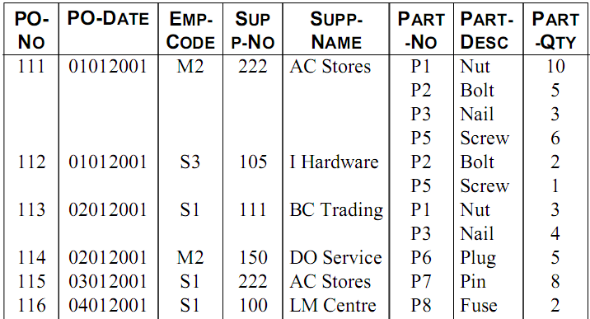
Purchase Order Relation

Slide 4
Purchase Order Relation in 0NF
PO( PO-NO, PO-DATE, EMP-CODE, SUPP-NO,
SUPP-NAME, PARTS-ORDERED{PART-NO, PART DESC, PART-QTY})

Slide 5
Purchase Order Relation in 0NF

Slide 6
1NF -Actions Required
1) Examine for repeat groups of data
2)Remove repeat groups from relation
3)Create new relation(s) to include repeated data
4)Include key of the 0NF to the new relation(s)
5)Determine key of the new relation(s)

Slide 7
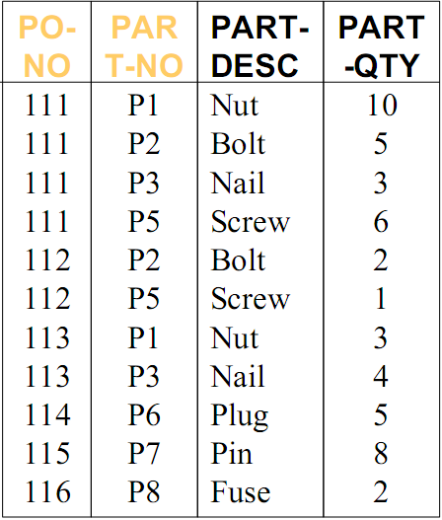
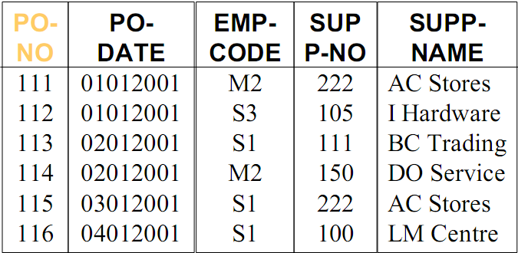
Purchase Order Relations in 1NF
PO-PART
PO

Slide 8
Problems -1NF
1.INSERT PROBLEM
do not know available parts until an order is placed
(e.g. P4 is bush)
2.DELETE PROBLEM
loose information of part P7 if we cancel purchase
order 115 (i.e. Delete PO-PART for Part No P7)
3.UPDATE PROBLEM:
to change description of Part P3 we need to change
every tuple in PO-PART containing Part No P3

Slide 9
Purchase Order Relations in 1NF
PO-PART
PO

Slide 10
PO-PART Relation (Parts Ordered) in 1NF
PO-PART( PO-NO, PART-NO, PART-DESC, PART-QTY)
Part Description is depended only on Part No,
which is part of the key of PO-PART.

Slide 11
Parts Ordered Relation in 1NF but not in 2NF

Slide 12
Second Normal Form -2NF
Deals with the relationship between non-key
and key fields
It is relevant when the key is composite,
i.e. consists of several fields

Slide 13
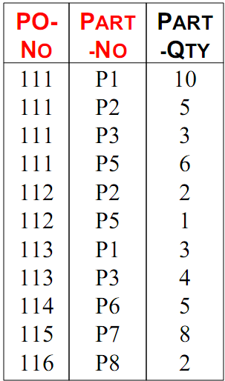
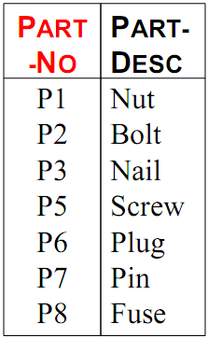
Parts Ordered Relations in 2NF
PO-PART
PART

Slide 14
Purchase Order Relations in 2NF

Slide 15
Problems -2NF
1. INSERT PROBLEM
cannot know available suppliers until an order is
placed (e.g. 200 is hardware stores)
2.DELETE PROBLEM
loose information of supplier 100 if we cancel
purchase order 116 (i.e. Delete PO for Supplier No
100)
3.UPDATE PROBLEM
to change name of Supplier 222 we need to change
every tuple in PO containing Supplier No 222

Slide 16
Third Normal Form -3NF
A relation is in 3NF if it is in 2NF and each
non-key attribute is only dependent on the
whole key, and not dependent on any non-key
attribute.
i.e. no transitive dependencies

Slide 17
Purchase Order Relations in 2NF

Slide 18
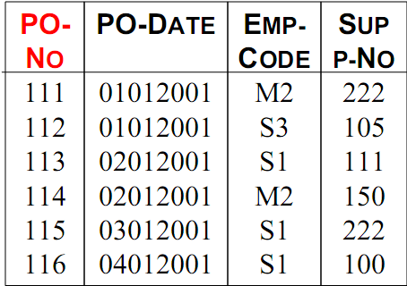
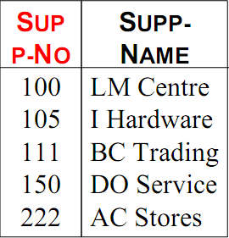
PO and SUPPLIER Relations in 3NF
PO
SUPPLIER

Slide 19
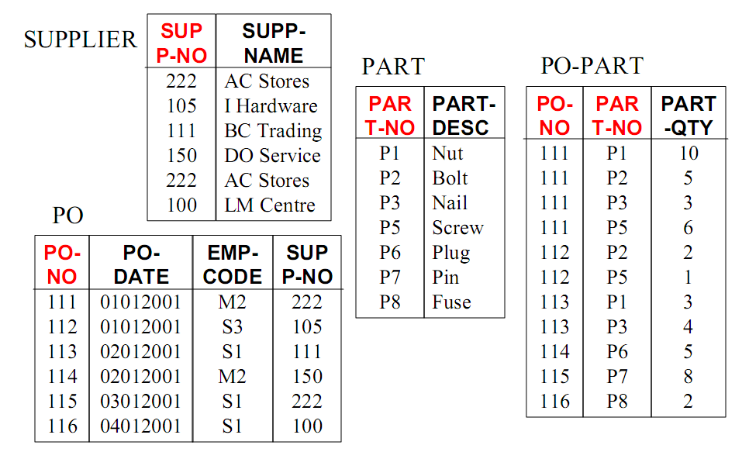
Purchase Order Relations in 3NF

Slide 20
End

